Slide 1
Steven Sasson
By charlotte Damian and Bianca doroudis

Slide 2
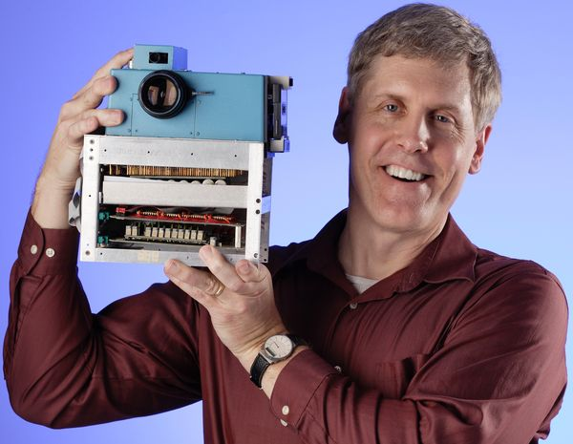
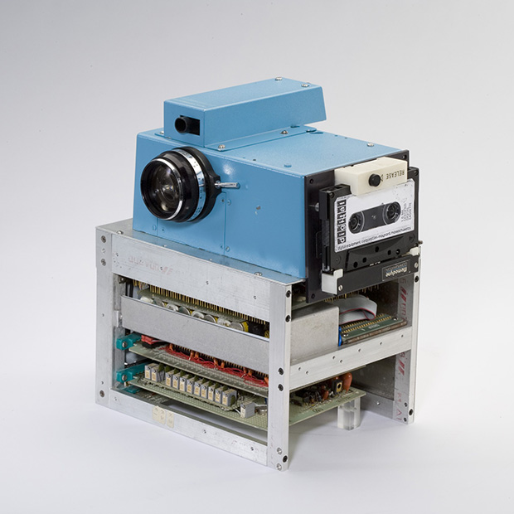
Birth
Steve Sasson was born on the 4th of July 1950
He was born in Brooklyn, New York in the United States of America.
Steve Sasson was not known very well until his invention.

Slide 3
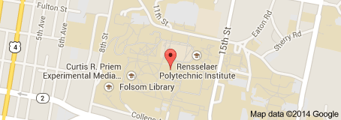
University
Steve Sasson was a 1972 and 1973 graduate.
He went to the university of Rensselaer polytechnic institute in electrical engineering.
Due to his study's he was a great engineer and that lead him to success with the digital camera

Slide 4
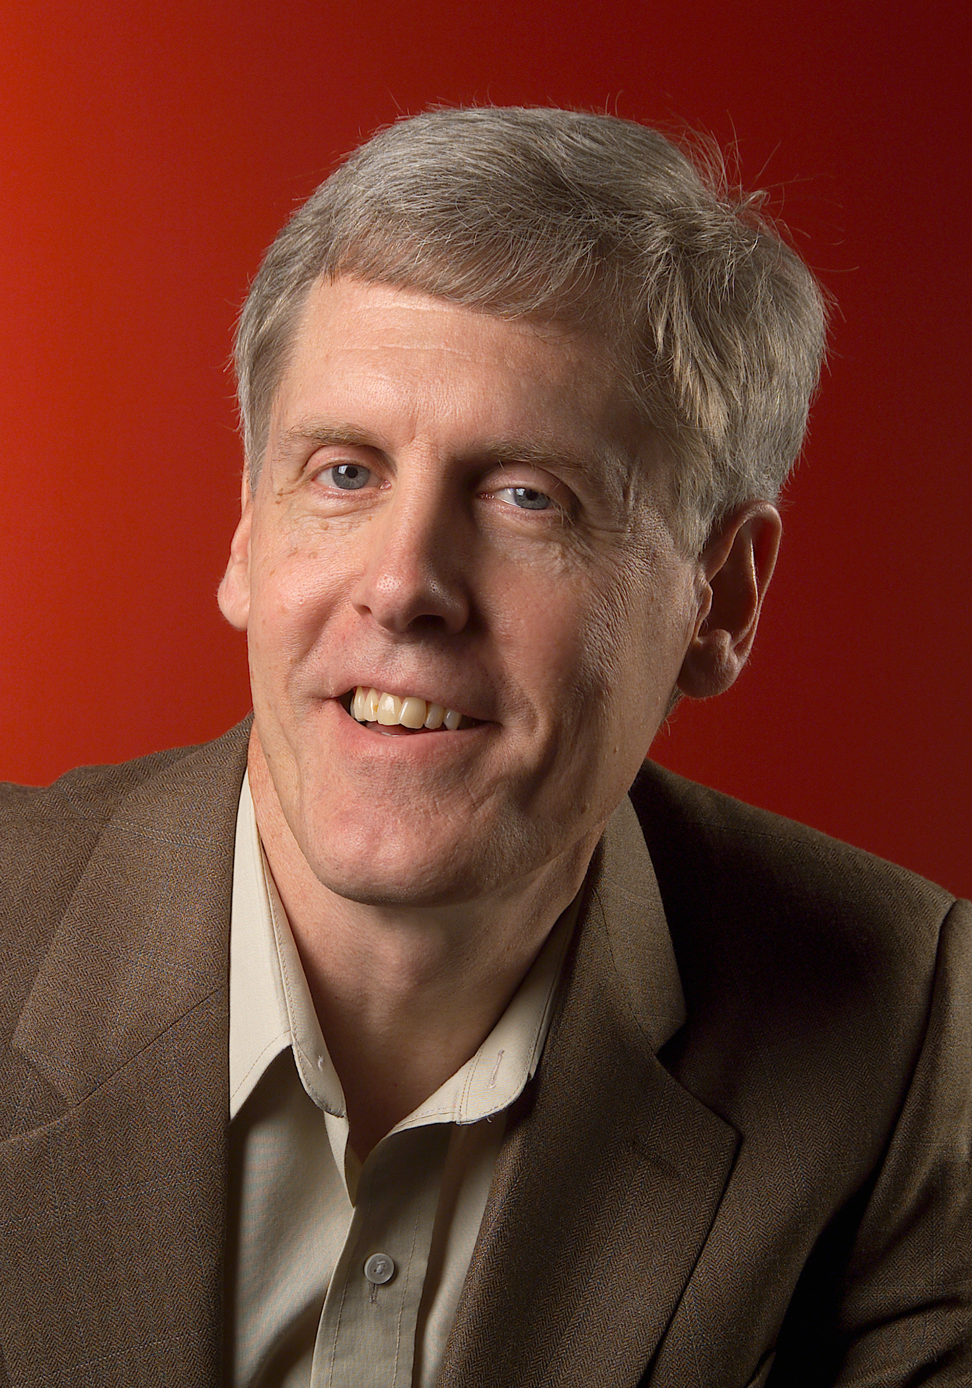
Where is he now?
Steve Sasson is now at the age of 64.
Steve sasson works at the Eastman Kodak Company.
He has always worked at the Eastman Kodak Company.
He enjoys working there
That is where he discovered the charge coupling device which-
Helped him event the digital camera

Slide 5
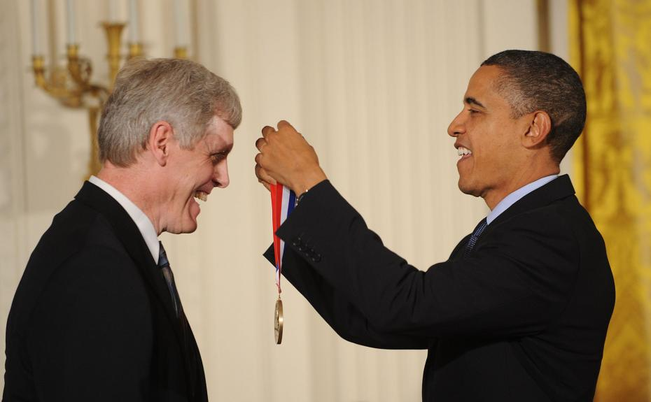
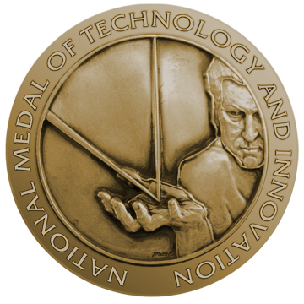
Awards
Steve Sasson has won many small awards.
Steve Sasson’s biggest honour was wining the National medal of technology and innovation.
He won this award in 2010
The medal was presented by Barack Obama in the East room of the white house.
It took place at 10:25pm on November 17th

